Slide 1

CSE 3521: Introduction to Artificial Intelligence
[Many slides are adapted from the UC Berkeley. CS188 Intro to AI at UC Berkeley and previous CSE 3521 course at OSU.]

Slide 2
Simple Wumpus Knowledge Base
For simplicity, only deal with the pits
Choose vocabulary
Let P_{i,j} be True if there is a pit in [i,j]
Let B_{i,j} be True if there is a breeze in [i,j]
KB sentences
FACT: “There is no pit in [1,1]”
R₁: ¬ P_{1,1}
RULE: “There is breeze in adjacent neighbor of pit”
R₂: B_{1,1} ⇔ (P_{1,2} ∨ P_{2,1} )
R₃: B_{2,1} ⇔ (P_{1,1} ∨ P_{2,2} ∨ P_{3,1} )
Need rule for each square!

Slide 3
Wumpus Environment
Given knowledge base
Include percepts as move through environment (online)
Need to “deduce what to do”
Derive chains of conclusions that lead to the desired goal
Use inference rules
Inference rule: “α derives β”
Knowing α is true, then β must also be true

Slide 4
Inference Rules for Prop. Logic
Modus Ponens
From implication and premise of implication, can infer conclusion

Slide 5
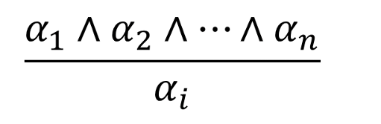
Inference Rules for Prop. Logic
And-Elimination
From conjunction, can infer any of the conjuncts

Slide 6
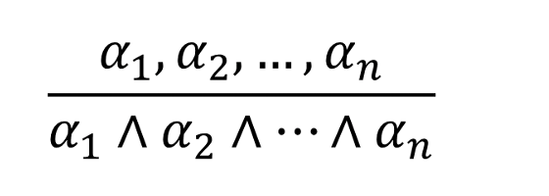
Inference Rules for Prop. Logic
And-Introduction
From list of sentences, can infer their conjunction

Slide 7
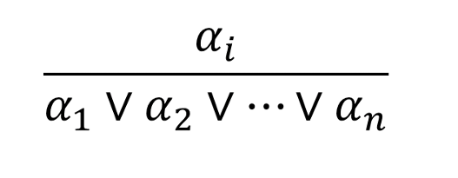
Inference Rules for Prop. Logic
Or-Introduction
From sentence, can infer its disjunction with anything else

Slide 8

Inference Rules for Prop. Logic
Double-Negation Elimination
From doubly negated sentence, can infer a positive sentence
$$\frac{¬¬α}{α}$$

Slide 9
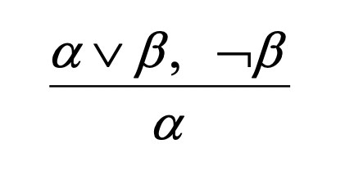
Inference Rules for Prop. Logic
Unit Resolution
From disjunction, if one of the disjuncts is false, can infer the other is true

Slide 10


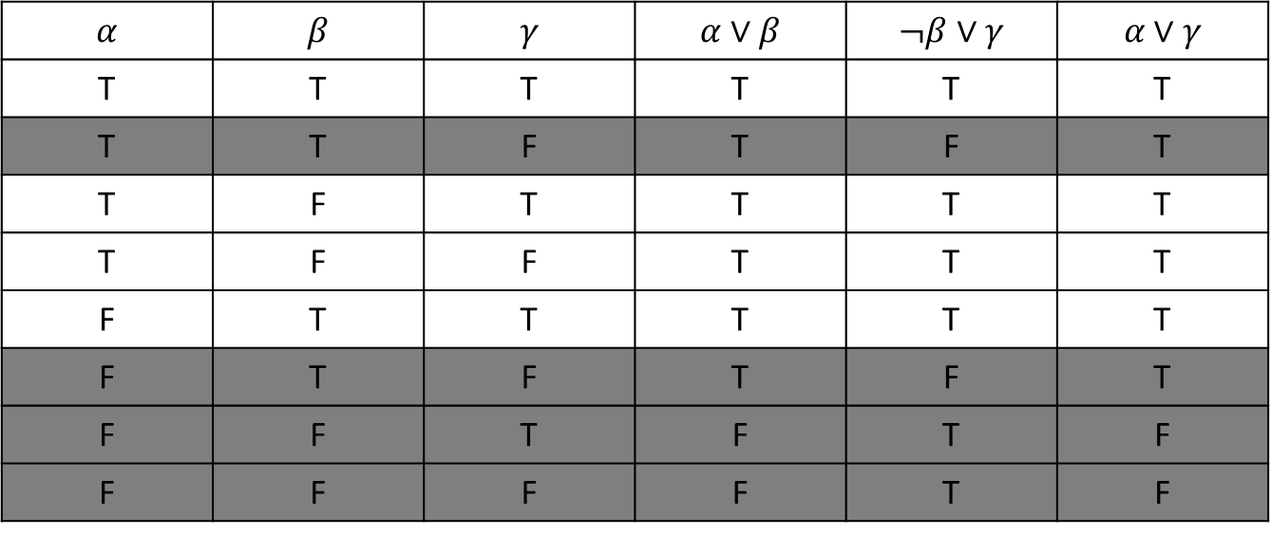
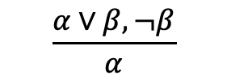



Inference Rules for Prop. Logic
Resolution
Most difficult because β cannot be both true and false
One of the other disjuncts must be true in one of the premises
(implication is transitive)
$$α$$ | $$β$$ | $$γ$$ | $$α∨β$$ | $$¬β∨γ$$ | $$α∨γ$$
T | T | T | T | T | T
T | T | F | T | F | T
T | F | T | T | T | T
T | F | F | T | T | T
F | T | T | T | T | T
F | T | F | T | F | T
F | F | T | F | T | F
F | F | F | F | T | F
$$¬β$$
OR
$$β$$
$$\frac{α∨β, ¬β}{α}$$
OR
$$\frac{¬β∨γ, β}{γ}$$
$$α$$
OR
$$γ$$

Slide 11
TASK: Find the Wumpus
Can we infer that the Wumpus is in cell (1,3), given our percepts and environment rules?
A = agent
B = breeze
OK = safe square
S = stench
V = visited
W = wumpus
4
W!
3
OK
S
OK
2
A
OK
OK
B
1
V
V
PIT
1 2 3 4

Slide 12
Wumpus Knowledge Base
Percept sentences (facts) “at this point”
¬ S_{1,1} ¬ B_{1,1}
¬ S_{2,1} B_{2,1}
S_{1,2} ¬ B_{1,2}
OK
S
2
A
OK
OK
B
1
V
V
1 2

Slide 13
Environment Rules
R₁: ¬ S_{1,1} ⇒ ¬ W_{1,1} ∧ ¬ W_{1,2} ∧ ¬ W_{2,1}
W?
3
OK
S
OK
2
A
OK
OK
1
1 2 3

Slide 14
Environment Rules
R₂: ¬ S_{2,1} ⇒ ¬ W_{1,1} ∧ ¬ W_{2,1} ∧ ¬ W_{2,2} ∧ ¬ W_{3,1}
W?
3
OK
S
OK
2
A
OK
OK
1
1 2 3

Slide 15
Environment Rules
R₃: ¬ S_{1,2} ⇒ ¬ W_{1,1} ∧ ¬ W_{1,2} ∧ ¬ W_{2,2} ∧ ¬ W_{1,3}
W?
3
OK
S
OK
2
A
OK
OK
1
1 2 3

Slide 16
Environment Rules
R₄: S_{1,2} ⇒ W_{1,3} ∨ W_{1,2} ∨ W_{2,2} ∨ W_{1,1}
3
OK
S
OK
2
A
OK
OK
1
1 2 3

Slide 17

Conclude W_{1,3} ?
Does the Wumpus reside in square (1,3) ?
In other words, can we infer W_{1,3} from our knowledge base?

Slide 18
Conclude W_{1,3} (Step #1)
Modus Ponens
R₁: ¬ S_{1,1} ⇒ ¬ W_{1,1} ∧ ¬ W_{1,2} ∧ ¬ W_{2,1}
Percept: ¬ S_{1,1}
Infer
¬ W_{1,1} ∧ ¬ W_{1,2} ∧ ¬ W_{2,1}

Slide 19
Conclude W_{1,3} (Step #2)
α₁˄ α₂˄…˄α_{n}
And-Elimination
¬ W_{1,1} ∧ ¬ W_{1,2} ∧ ¬ W_{2,1}
Infer
¬ W_{1,1} ¬ W_{1,2} ¬ W_{2,1}
α_{i}

Slide 20
Conclude W_{1,3} (Step #3)
Modus Ponens
R₂: ¬ S_{2,1} ⇒ ¬ W_{1,1} ∧ ¬ W_{2,1} ∧ ¬ W_{2,2} ∧ ¬ W_{3,1}
Percept: ¬ S_{2,1}
Infer
¬ W_{1,1} ∧ ¬ W_{2,1} ∧ ¬ W_{2,2} ∧ ¬ W_{3,1}
And-Elimination
¬ W_{1,1} ¬ W_{2,1} ¬ W_{2,2} ¬ W_{3,1}
α₁˄ α₂˄…˄α_{n}
α_{i}

Slide 21
Conclude W_{1,3} (Step #4)
Modus Ponens
R₄: S_{1,2} ⇒ W_{1,3} ∨ W_{1,2} ∨ W_{2,2} ∨ W_{1,1}
Percept: S_{1,2}
Infer
W_{1,3} ∨ W_{1,2} ∨ W_{2,2} ∨ W_{1,1}

Slide 22
Conclude W_{1,3} (Step #5)
Unit Resolution
W_{1,3} ∨ W_{1,2} ∨ W_{2,2} ∨ W_{1,1} from Step #4
¬ W_{1,1} from Step #2
Infer
W_{1,3} ∨ W_{1,2} ∨ W_{2,2}

Slide 23
Conclude W_{1,3} (Step #6)
Unit Resolution
W_{1,3} ∨ W_{1,2} ∨ W_{2,2} from Step #5
¬ W_{2,2} from Step #3
Infer
W_{1,3} ∨ W_{1,2}

Slide 24
Conclude W_{1,3} (Step #7)
Unit Resolution
W_{1,3} ∨ W_{1,2} from Step #6
¬ W_{1,2} from Step #2
Infer
W_{1,3} → The wumpus is in cell 1,3!!!

Slide 25
Wumpus in W_{1,3}
W!
3
OK
S
OK
2
A
OK
OK
1
1 2 3

Slide 26
Propositional Logic
Propositional logic commits to existence of facts about the world being represented
Simple syntax and semantics
Proof methods
Truth table
Inference rules
Modus Ponens
And-Elimination
And/Or-Introduction
Double-Negation Elimination
Unit Resolution
Resolution
Propositional logic quickly becomes impractical

Slide 27
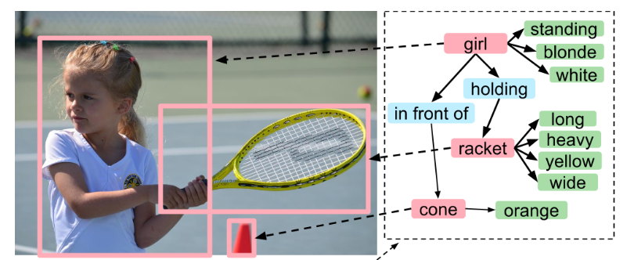
First-Order Logic
Also called first-order predicate calculus
FOL, FOPC
Makes stronger commitments
World consists of objects
Things with identities
e.g., people, houses, colors, …
Objects have properties/relations that distinguish them from other objects
e.g., Properties: red, round, square, …
e.g., Relations: brother of, bigger than, inside, …
Have functional relations
Return the object with a certain relation to given “input” object
The “inverse” of a (binary) relation
e.g., father of, best friend

Slide 28
Examples of Facts as Objects and Properties or Relations
“Squares neighboring the Wumpus are smelly”
Objects
Wumpus, squares
Property
Smelly
Relation
Neighboring

Slide 29
Syntax of FOL: Basic Elements
Constant symbols for specific objects
KingJohn, 2, OSU, …
Variables
x, y, a, b, …
Predicate properties (unary) / relations (pairwise or more)
Smart(), Brother(), Married(), >, …
Functions (return objects)
Sqrt() , LeftTo(), FatherOf(), …
Connectives
∧ ∨ ¬ ⇒ ⇔
Quantifiers
∀ ∃
Equality
=

Slide 30
Atomic Sentences
Collection of terms and relation(s) together to state facts
Atomic sentence
predicate(term₁, …, term_{n})
Or term₁ = term_{n}
Examples
Brother(Richard, John)
Married(FatherOf(Richard), MotherOf(John))

Slide 31
Complex Sentences
Made from atomic sentences using logical connectives
¬S, S₁ ∧ S₂, S₁ ∨ S₂, S₁ ⇒ S₂, S₁ ⇔ S₂
Examples:
Older(John, 30) ⇒ ¬Younger(John, 30)
> (1,2) ∨ ≤(1,2)

Slide 32
Quantifiers
Currently have logic that allows objects
Now want to express properties of entire collections of objects
Rather than enumerate the objects by name
Two standard quantifiers
Universal ∀
Existential ∃

Slide 33
Universal Qualification
“For all …” (typically use implication ⇒)
Allows for “rules” to be constructed
∀ <variables> <sentence>
Everyone at OSU is smart
∀x At(x, OSU) ⇒ Smart(x)
∀x P is equivalent to conjunction of all instantiations of P
(At(John, OSU) ⇒ Smart(John)) ∧ (At(Bob, OSU) ⇒ Smart(Bob) ∧ (At(Mary, OSU) ⇒ Smart(Mary)) ∧ …

Slide 34
Existential Quantification
“There exists …” (typically use conjunction ∧)
Makes a statement about some object (not all)
∃ <variables> <sentences>
Someone at OSU is smart
∃x At(x, OSU) ∧ Smart(x)
∃ x P is equivalent to disjunction of all instantiations of P
(At(John, OSU) ∧ Smart(John)) ∨ (At(Bob, OSU) ∧ Smart(Bob)) (At(Mary, OSU) ∧ Smart(Mary)) ∨ …
Uniqueness quantifier
∃! x says a unique object exists (i.e. there is exactly one)

Slide 35
Properties of Quantifiers
Quantifier duality: Each can be expressed using the other
∀x Person(x) ⇒ Likes(x, IceCream) “Everybody likes ice cream”
¬∃x Person(x) ∧ ¬Likes(x, IceCream) “Not exist anyone who does not like ice cream”
∃x Person(x) ∧ Likes(x, Broccoli) “Someone likes broccoli”
¬∀x Person(x) ⇒ ¬Likes(x, Broccoli) “Not the case that everyone does not like broccoli”

Slide 36
Properties of Quantifiers
Important relations
∃x P(x) = ¬∀x ¬P(x)
∀x P(x) = ¬∃x ¬P(x)
P(x) ⇒ Q(x) is same as ¬P(x) ∨ Q(x)
¬ (P(x) ∧ Q(x)) is same as ¬P(x) ∨ ¬Q(x)

Slide 37
Proof: Check the Truth Table
P | Q | P ⇒ Q
False | False | TRUE
False | True | TRUE
True | False | FALSE
True | True | TRUE
P(x) ⇒ Q(x)
is same as
¬P(x) ∨ Q(x)
P | Q | ¬P | ¬P ∨ Q
False | False | True | TRUE
False | True | True | TRUE
True | False | False | FALSE
True | True | False | TRUE

Slide 38
Proof : Check the Truth Table
P | Q | P ∧ Q | ¬(P ∧ Q)
False | False | False | TRUE
False | True | False | TRUE
True | False | False | TRUE
True | True | True | FALSE
¬(P(x) ∧ Q(x))
is same as
¬P(x) ∨ ¬Q(x)
P | Q | ¬P | ¬Q | ¬P ∨ ¬Q
False | False | True | True | TRUE
False | True | True | False | TRUE
True | False | False | True | TRUE
True | True | False | False | FALSE

Slide 39
Proof : Check the Truth Table
P | Q | P ∨ Q | ¬(P ∨ Q)
False | False | False | TRUE
False | True | True | FALSE
True | False | True | FALSE
True | True | True | FALSE
¬(P(x) ∨ Q(x))
is same as
¬P(x) ∧ ¬Q(x)
P | Q | ¬P | ¬Q | ¬P ∧ ¬Q
False | False | True | True | TRUE
False | True | True | False | FALSE
True | False | False | True | FALSE
True | True | False | False | FALSE

Slide 40
Conversion Example
∀x Person(x) ⇒ Likes(x, IceCream) [use: ∀x P(x) = ¬∃x ¬P(x)]
¬∃x ¬(Person(x) ⇒ Likes(x, IceCream)) [use: P(x) ⇒ Q(x) is same as ¬P(x) ∨ Q(x)]
¬∃x ¬(¬Person(x) ∨ Likes(x, IceCream)) [distribute negatives]
¬∃x Person(x) ∧ ¬Likes(x, IceCream)
¬x == (¬x)

